Slide 1
Movie Recommendation
Alternating Least Squares (ALS) algorithm with Spark APIs

Slide 2
Table of Content
01
Introduction
04
Spark ALS based approach for training model
ALS Model Selection and Evaluation
Model testing
Model application and performance
02
Data ETL and Data Exploration
03
05
Movie Recommendation
To specific users
Find similar movies
Spark SQL and OLAP
Users focused
Movie focused
Rating focused
Genres focused
06
Insights and Conclusion

Slide 3
01 Introduction
Vision
Recommendation system has become integral part of many online platforms given it’s use in increasing sales and customer retention. Alternating least square matrix factorization method, a collaborative filtering algorithm. This project will use ALS to build a movie recommendation system based on data from grouplens .
Terminologies
Apache Spark: Apache Spark is an open-source distributed general-purpose cluster-computing framework.
Alternating least square(ALS) matrix factorization: The idea is to take a large (or potentially huge) matrix and factor it into some smaller representation of the original matrix through alternating least squares. We end up with two or more lower dimensional matrices whose product equals the original one.

Slide 4
02 Data ETL
& Data Exploration
01
02
03
Dataset Introduction
Dataset used
Basic Information
(Small: 100,000 ratings and 3,600 tag applications applied to 9,000 movies by 600 users)
movies_df: movieId, title, genres
ratings_df:userId, movieId, rating, timestamp
links_df:imdbId movieId,, tmdbId
tags_df:userId, movieId, tag, timestamp
Minimum number of ratings per user is 20;
Minimum number of ratings per movie is 1
3446 out of 9724 movies are rated by only one user

Slide 5
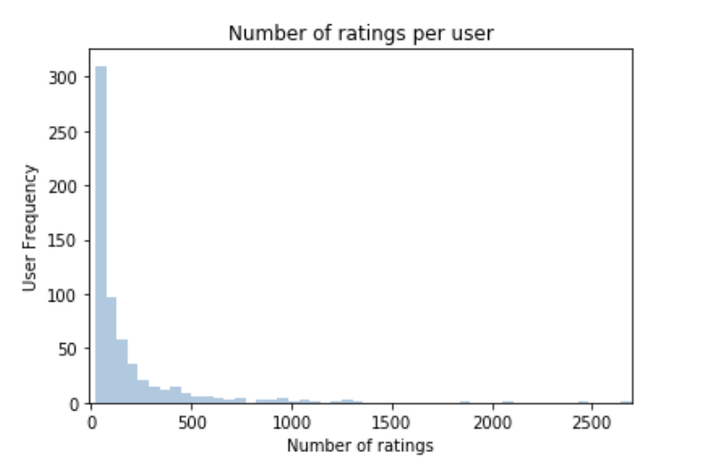
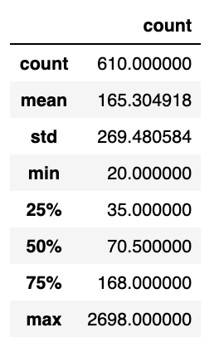
03 Spark SQL & OLAP
3-1 Users
The total number of users is 610
Based on the Distribution of user vs number of ratings:
The max number of rating is 2698, the min number of rating is 20. Half of the users rated no more than 70 movies.

Slide 6
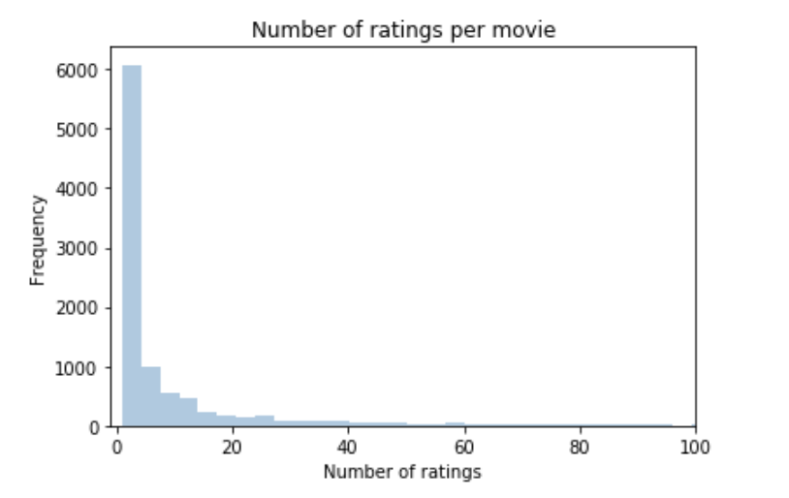
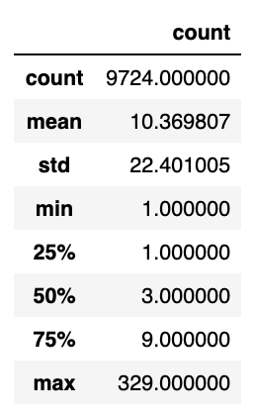
03 Spark SQL & OLAP
3-2 Movies
The total number of movies is 9742
Based on the Distribution of movies vs number of ratings:
Among rated 9724 movies, the max number of rating is 329, the min is 1, and >75% movies were rated <10 times.

Slide 7
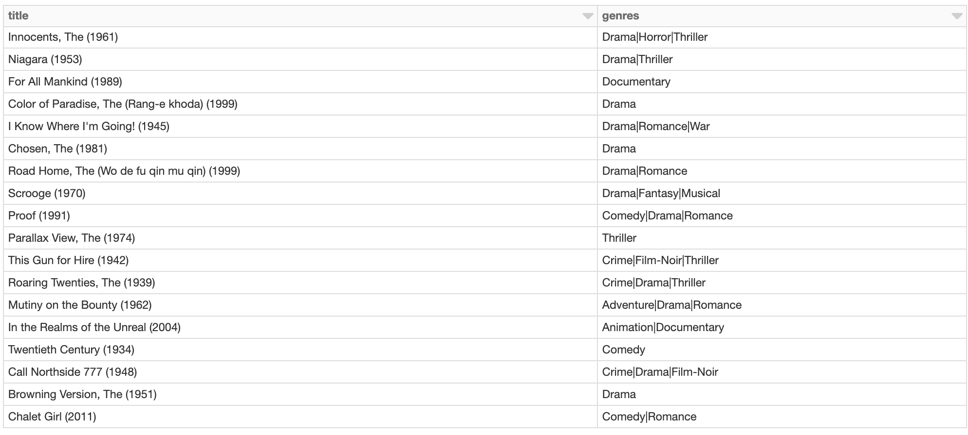
03 Spark SQL & OLAP
3-3 Ratings
There are 18 movies not rated before.
List movies not rated before:

Slide 8
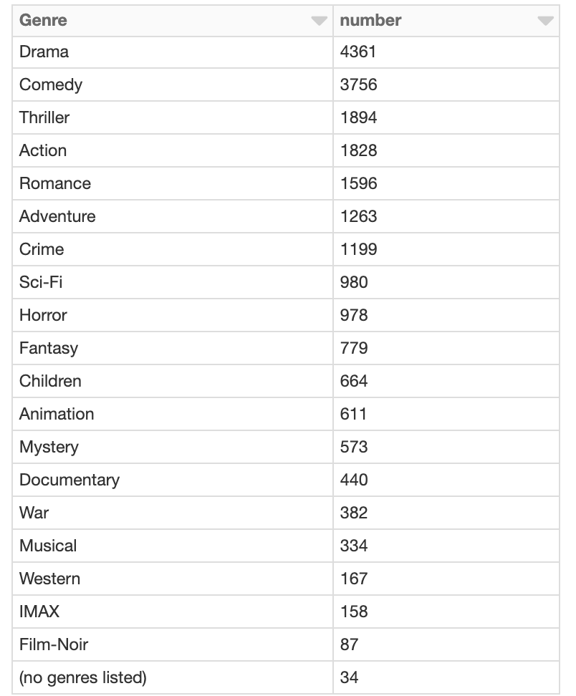
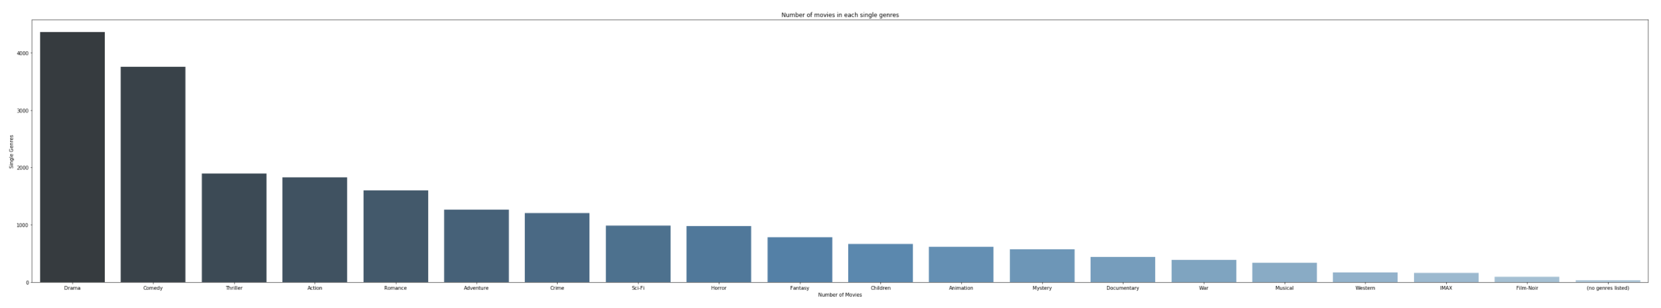
03 Spark SQL & OLAP
3-4 Genres
There are 951 distinct combinations of movie genres
Number of single genres is 20
The table shows the number of movies in each single genre.
Distributions of number of movies in single genres. >4000 movies belong to drama, >3000 belong to comedy.

Slide 9
04 Spark ALS based approach for training model
ALS Model Selection and Evaluation
Split the dataset into train set 80% and test set 20%
Build the recommendation model using ALS on the training data
Tune model using ParamGridBuilder
Define evaluator as RMSE
Build Cross validation
Fit ALS model to training data
Extract best model from the tuning exercise using ParamGridBuilder

Slide 10
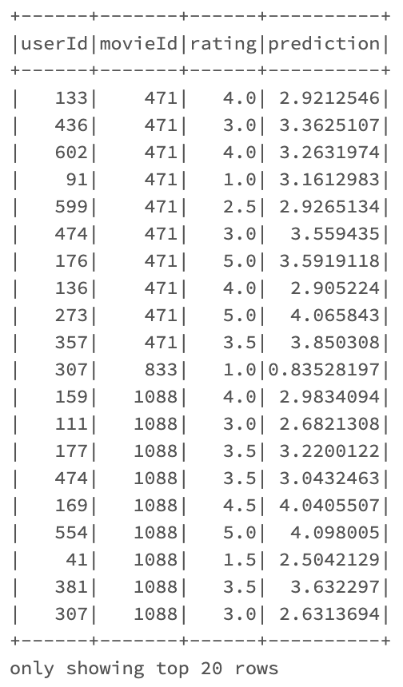
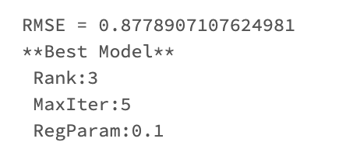
04 Spark ALS based approach for training model
Show the top 20 rows of predictions
Model testing
Generate predictions and evaluate using RMSE

Slide 11
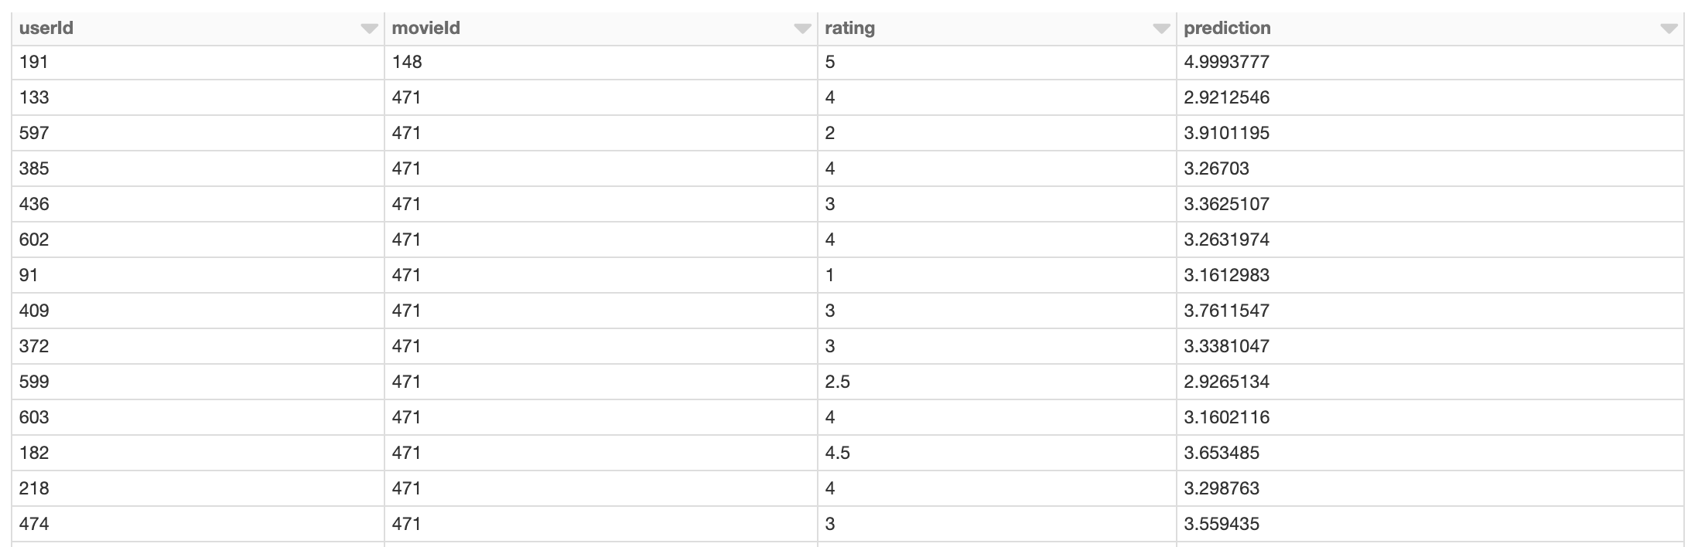
04 Spark ALS based approach for training model
Model Application and Performance
RMSE = 0.739279769391542

Slide 12
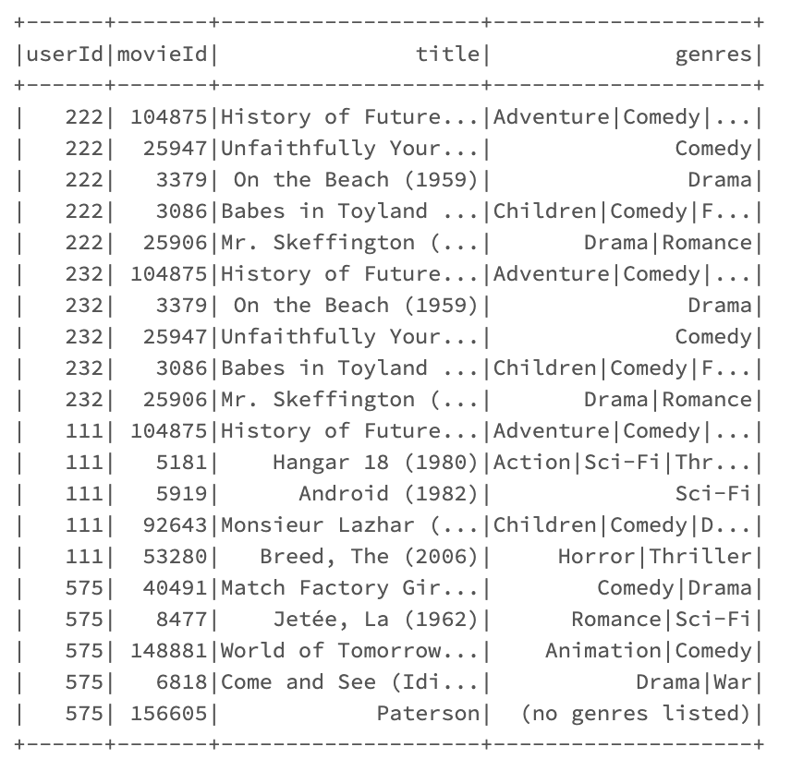
05 Movie Recommendation
5-1 To specific users Id: 222, 232, 111, 575
Based on the model,
Recommend 5 movies for each specific user.

Slide 13
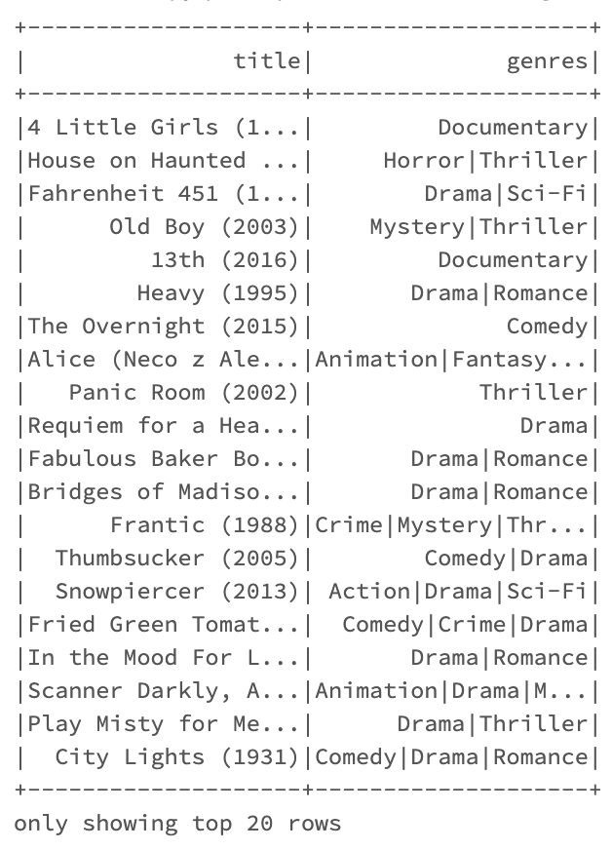
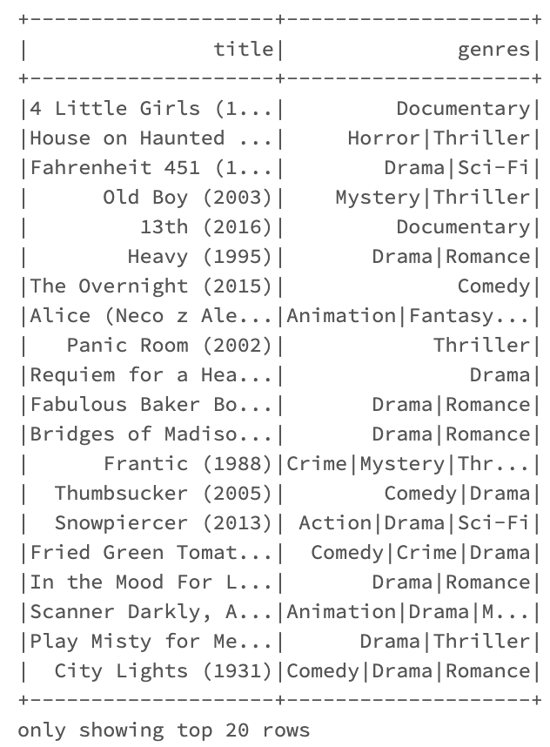
05 Movie Recommendation
5-1 Find similar movies for movie Id: 258, 471
Movie 471:
Movie 258:

Slide 14
06 Insights and Conclusion
Insights
Based on this recommendation system powered by ALS model, users can be given a personalized suggestions based on their previous ratings of multiple genres of movies.
Customer: customers can find a set of movies that suits them more easily, instead of having to search for specific types of movies through their own research. Therefore, this is a more efficient process, and customer satisfaction will increase as a result of the better experience.
Profitability and Development: If the user need to pay for the movies, The expected conversion rate will increase, the transaction volume and revenue of the website will increase. Accordingly, the company's profits will improve, which will support the company's long-term development and growth.
Market share: From a long-term perspective, the recommendation system can help the company continue to expand and eventually become a market giant.
Conclusion
The recommendation system helps customers choose movies so we can increase our profit as well as occupy more market share and gain advantages in competition with other websites.

Slide 15
References
Dataset
https://grouplens.org/datasets/movielens/latest/
Victor (2017) ALS Implicit Collaborative Filtering
https://medium.com/radon-dev/als-implicit-collaborative-filtering-5ed653ba39fe

Slide 16
Thank you!

